Slide 1
UNIT 3-S2 DISPLAY DEVICES,LIGHT SOURCES AND DETECTION DEVICES

Slide 2
INJECTION LUMINESCENCE
If a p-n junction diode is forward biased, the majority carriers from both sides cross the junction and enter the opposite sides.
This results in an increase in the minority carrier concentration on the two sides.
The excess minority carrier concentration, of course, depends on the impurity levels on the two sides.
This process is known as minority carrier injection.
The injected carriers diffuse away from the junction, recombining with majority carriers as they do so.
This recombination process of electrons with holes may be either nonradiative, in which the energy difference of the two carriers is released into the lattice as thermal energy, or radiative, in which a photon of energy equal to or less than the energy difference of the carriers is radiated.
The phenomenon of emission of radiation by the recombination of injected carriers is called injection luminescence. A p-n junction diode exhibiting this phenomenon is referred to as a light-emitting diode.

Slide 3

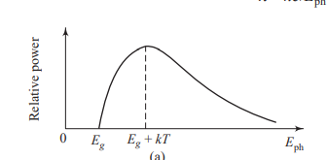
The spectral distribution of the radiated power P as a function of Eph is given by the following expression:
where α is a constant. The theoretical plot of relative power versus E_{ph} is shown in Fig

Slide 4
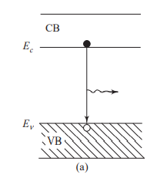
Radiation may be emitted via
i)The recombination of an electron in the CB with a hole in the VB .

Slide 5
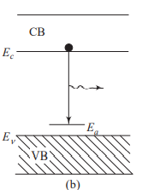
ii)The downward transition of an electron in the CB to an empty acceptor level, shown in Fig.

Slide 6
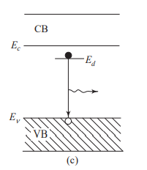
iii) The transition of an electron from a filled donor level to a hole in the VB, shown in Fig.

Slide 7

Spectrum of Injection Luminescence
If the transition takes place from the electron level at the bottom of the CB to the hole level at the top of the VB, the emitted photon will have energy
where h is Planck’s constant, c is the speed of light, and l is the wavelength of emitted radiation.
However, there is a distribution of electron energy levels in the CB and that of holes in the VB.
Thus, depending on the energy levels involved, there will be a range of photon energies that are emitted by the LED

Slide 8
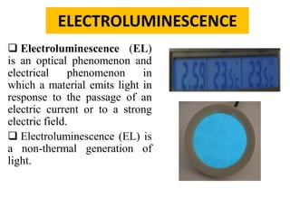
4

Slide 9
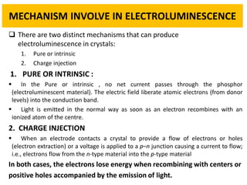

Slide 10
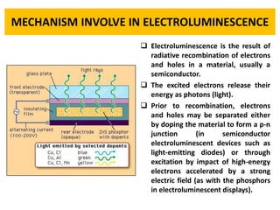

Slide 11
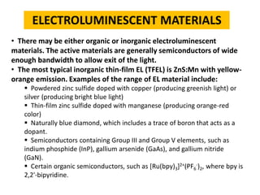

Slide 12
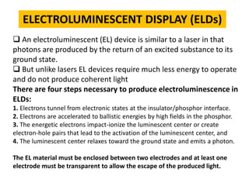

Slide 13
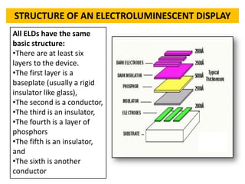

Slide 14
Electro-luminescence
Electro-luminescence occurs in devices with p-n rectifying junctions which are stimulated by an externally applied voltage.
When a forward biased voltage is applied across the device, electrons and holes recombine at the junction and emit photons in the visible range (mono-chromatic light i.e. singe color). These diodes are called light emitting diodes (LEDs).
LEDs emit light of many colors, from red to violet, depending on the composition of the semiconductor material used. Ex.: GaAs, GaP, GaAlAs, and GaAsP are typical materials for LEDs.

Slide 15
Electro luminescence
Electroluminescence (EL) is an optical phenomenon and electrical phenomenon in which a material emits light in response to the passage of an electric current or to a strong electric field.
Electroluminescence is the result of radiative recombination of electrons & holes in a material, usually a semiconductor.
The excited electrons release their energy as photons - light. Prior to recombination, electrons and holes may be separated either by doping the material to form a p-n junction (in semiconductor electroluminescent devices such as light-emitting diodes) or through excitation by impact of high-energy electrons accelerated by a strong electric field (as with the phosphors in electroluminescent displays).

Slide 16
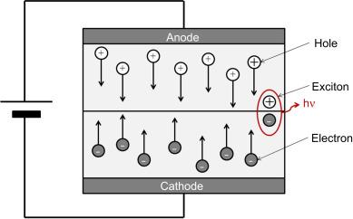

Slide 17
Electroluminescent devices are fabricated using either organic or inorganic electroluminescent materials. The active materials are generally semiconductors of wide enough bandwidth to allow the exit of the light.
The most typical inorganic thin-film EL (TFEL) is ZnS:Mn with yellow-orange emission. Examples of the range of EL material include:
Powdered zinc sulfide doped with copper (producing greenish light) or silver (producing bright blue light)
Thin-film zinc sulfide doped with manganese (producing orange-red color)
Naturally blue diamond, which includes a trace of boron that acts as a dopant.
Semiconductors containing Group III and Group V elements, such as indium phosphide (InP), gallium arsenide (GaAs), and gallium nitride (GaN) (Light-emitting diodes)

Slide 18
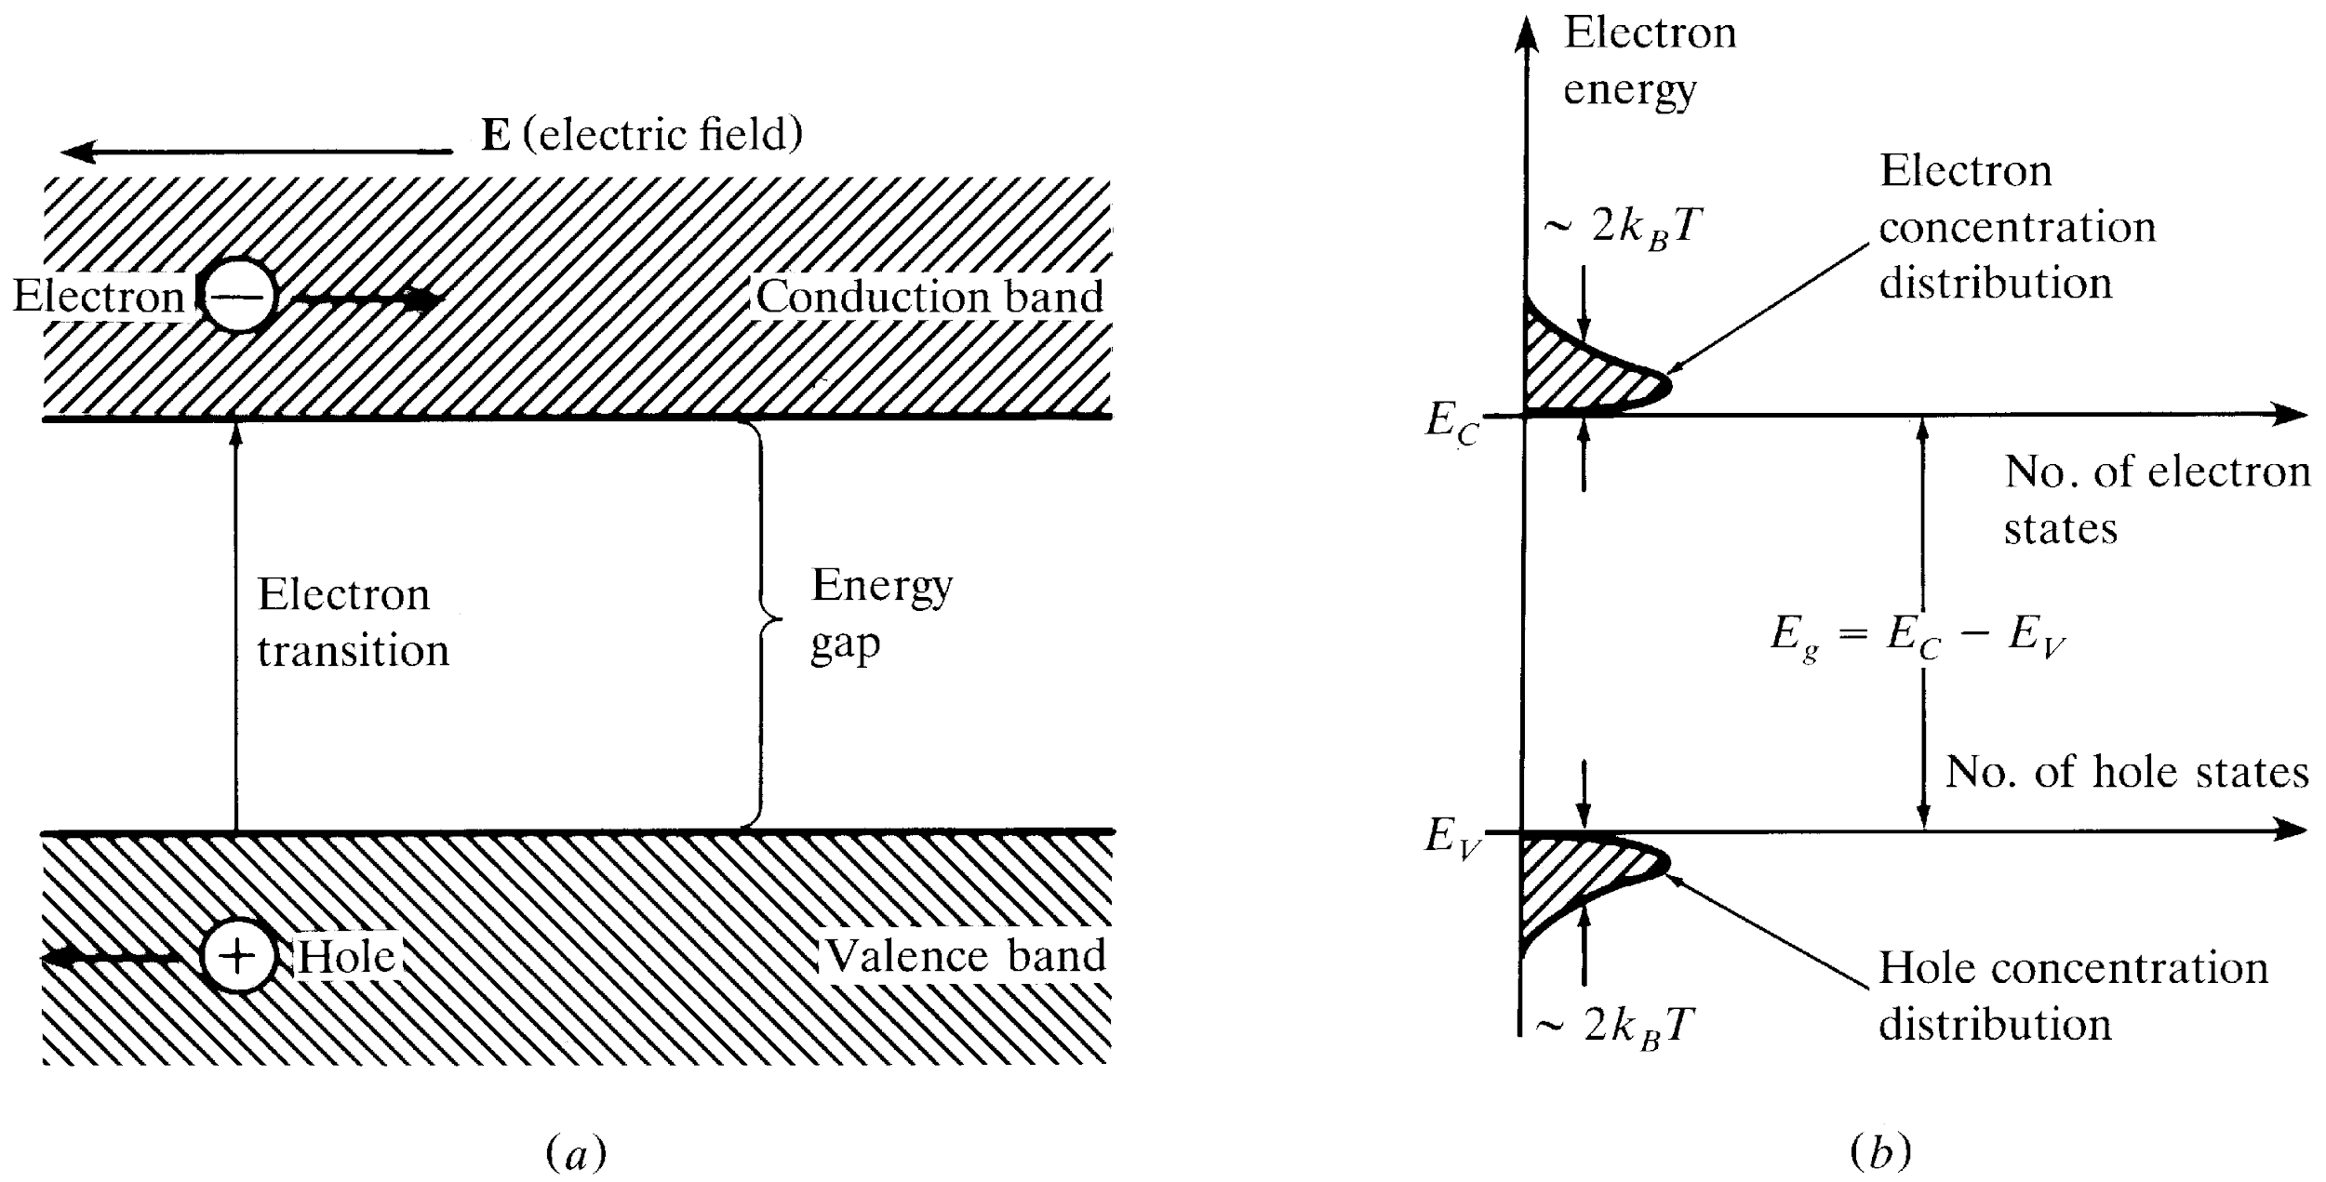
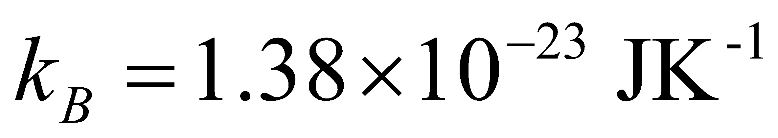
Review of Semiconductor Physics
a) Energy level diagrams showing the excitation of an electron from the valence band to the conduction band.
The resultant free electron can freely move under the application of electric field.
b) Equal electron & hole concentrations in an intrinsic semiconductor created by the thermal excitation of
electrons across the band gap
Optical Fiber communications, 3rd ed.,G.Keiser,McGrawHill, 2000

Slide 19
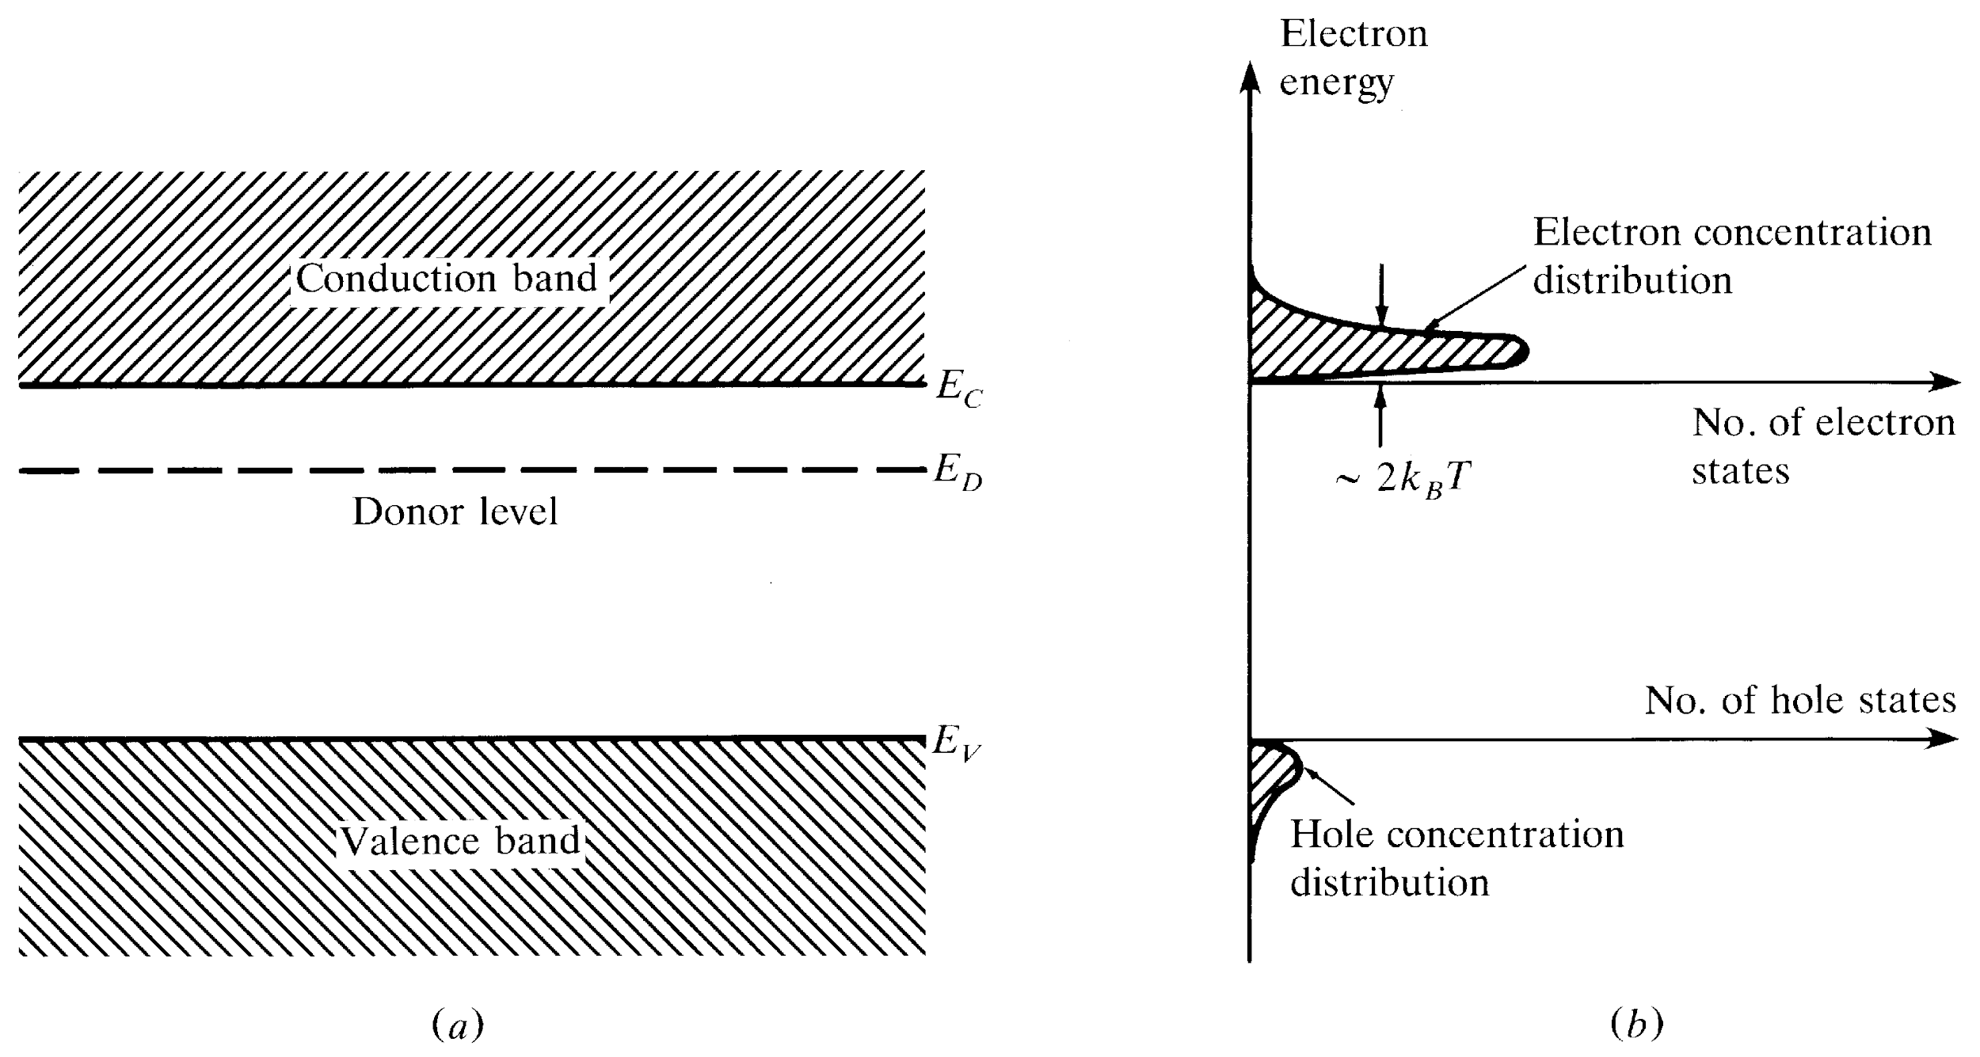
n-Type Semiconductor
Donor level in an n-type semiconductor.
The ionization of donor impurities creates an increased electron concentration distribution.
Optical Fiber communications, 3rd ed.,G.Keiser,McGrawHill, 2000

Slide 20
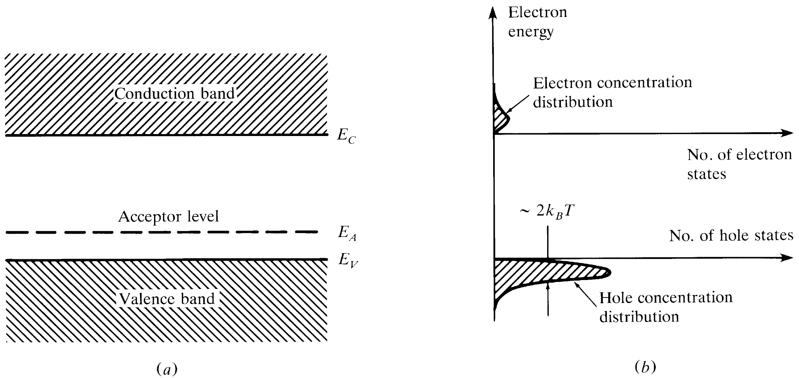
p-Type Semiconductor
Acceptor level in an p-type semiconductor.
The ionization of acceptor impurities creates an increased hole concentration distribution
Optical Fiber communications, 3rd ed.,G.Keiser,McGrawHill, 2000

Slide 21
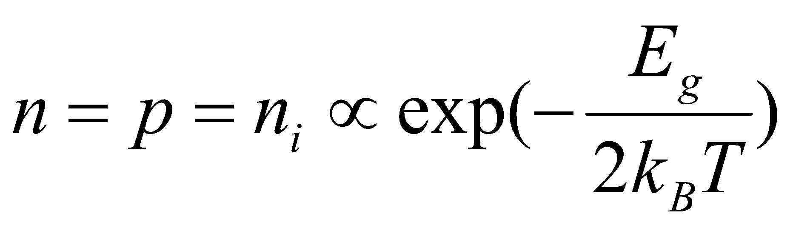

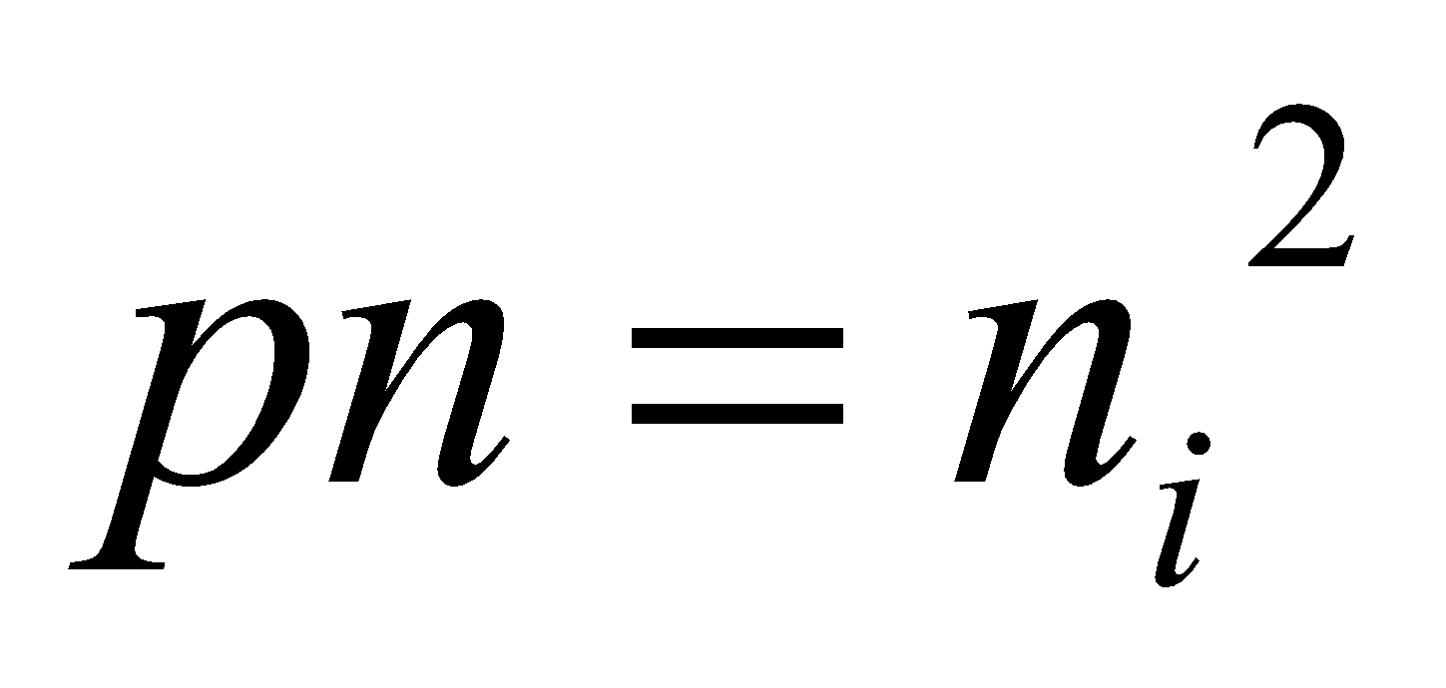
Intrinsic & Extrinsic Materials
Intrinsic material: A perfect material with no impurities.
Extrinsic material: donor or acceptor type semiconductors.
Majority carriers: electrons in n-type or holes in p-type.
Minority carriers: holes in n-type or electrons in p-type.
The operation of semiconductor devices is essentially based on the injection and extraction of minority carriers.
[4-1]
[4-2]

Slide 22
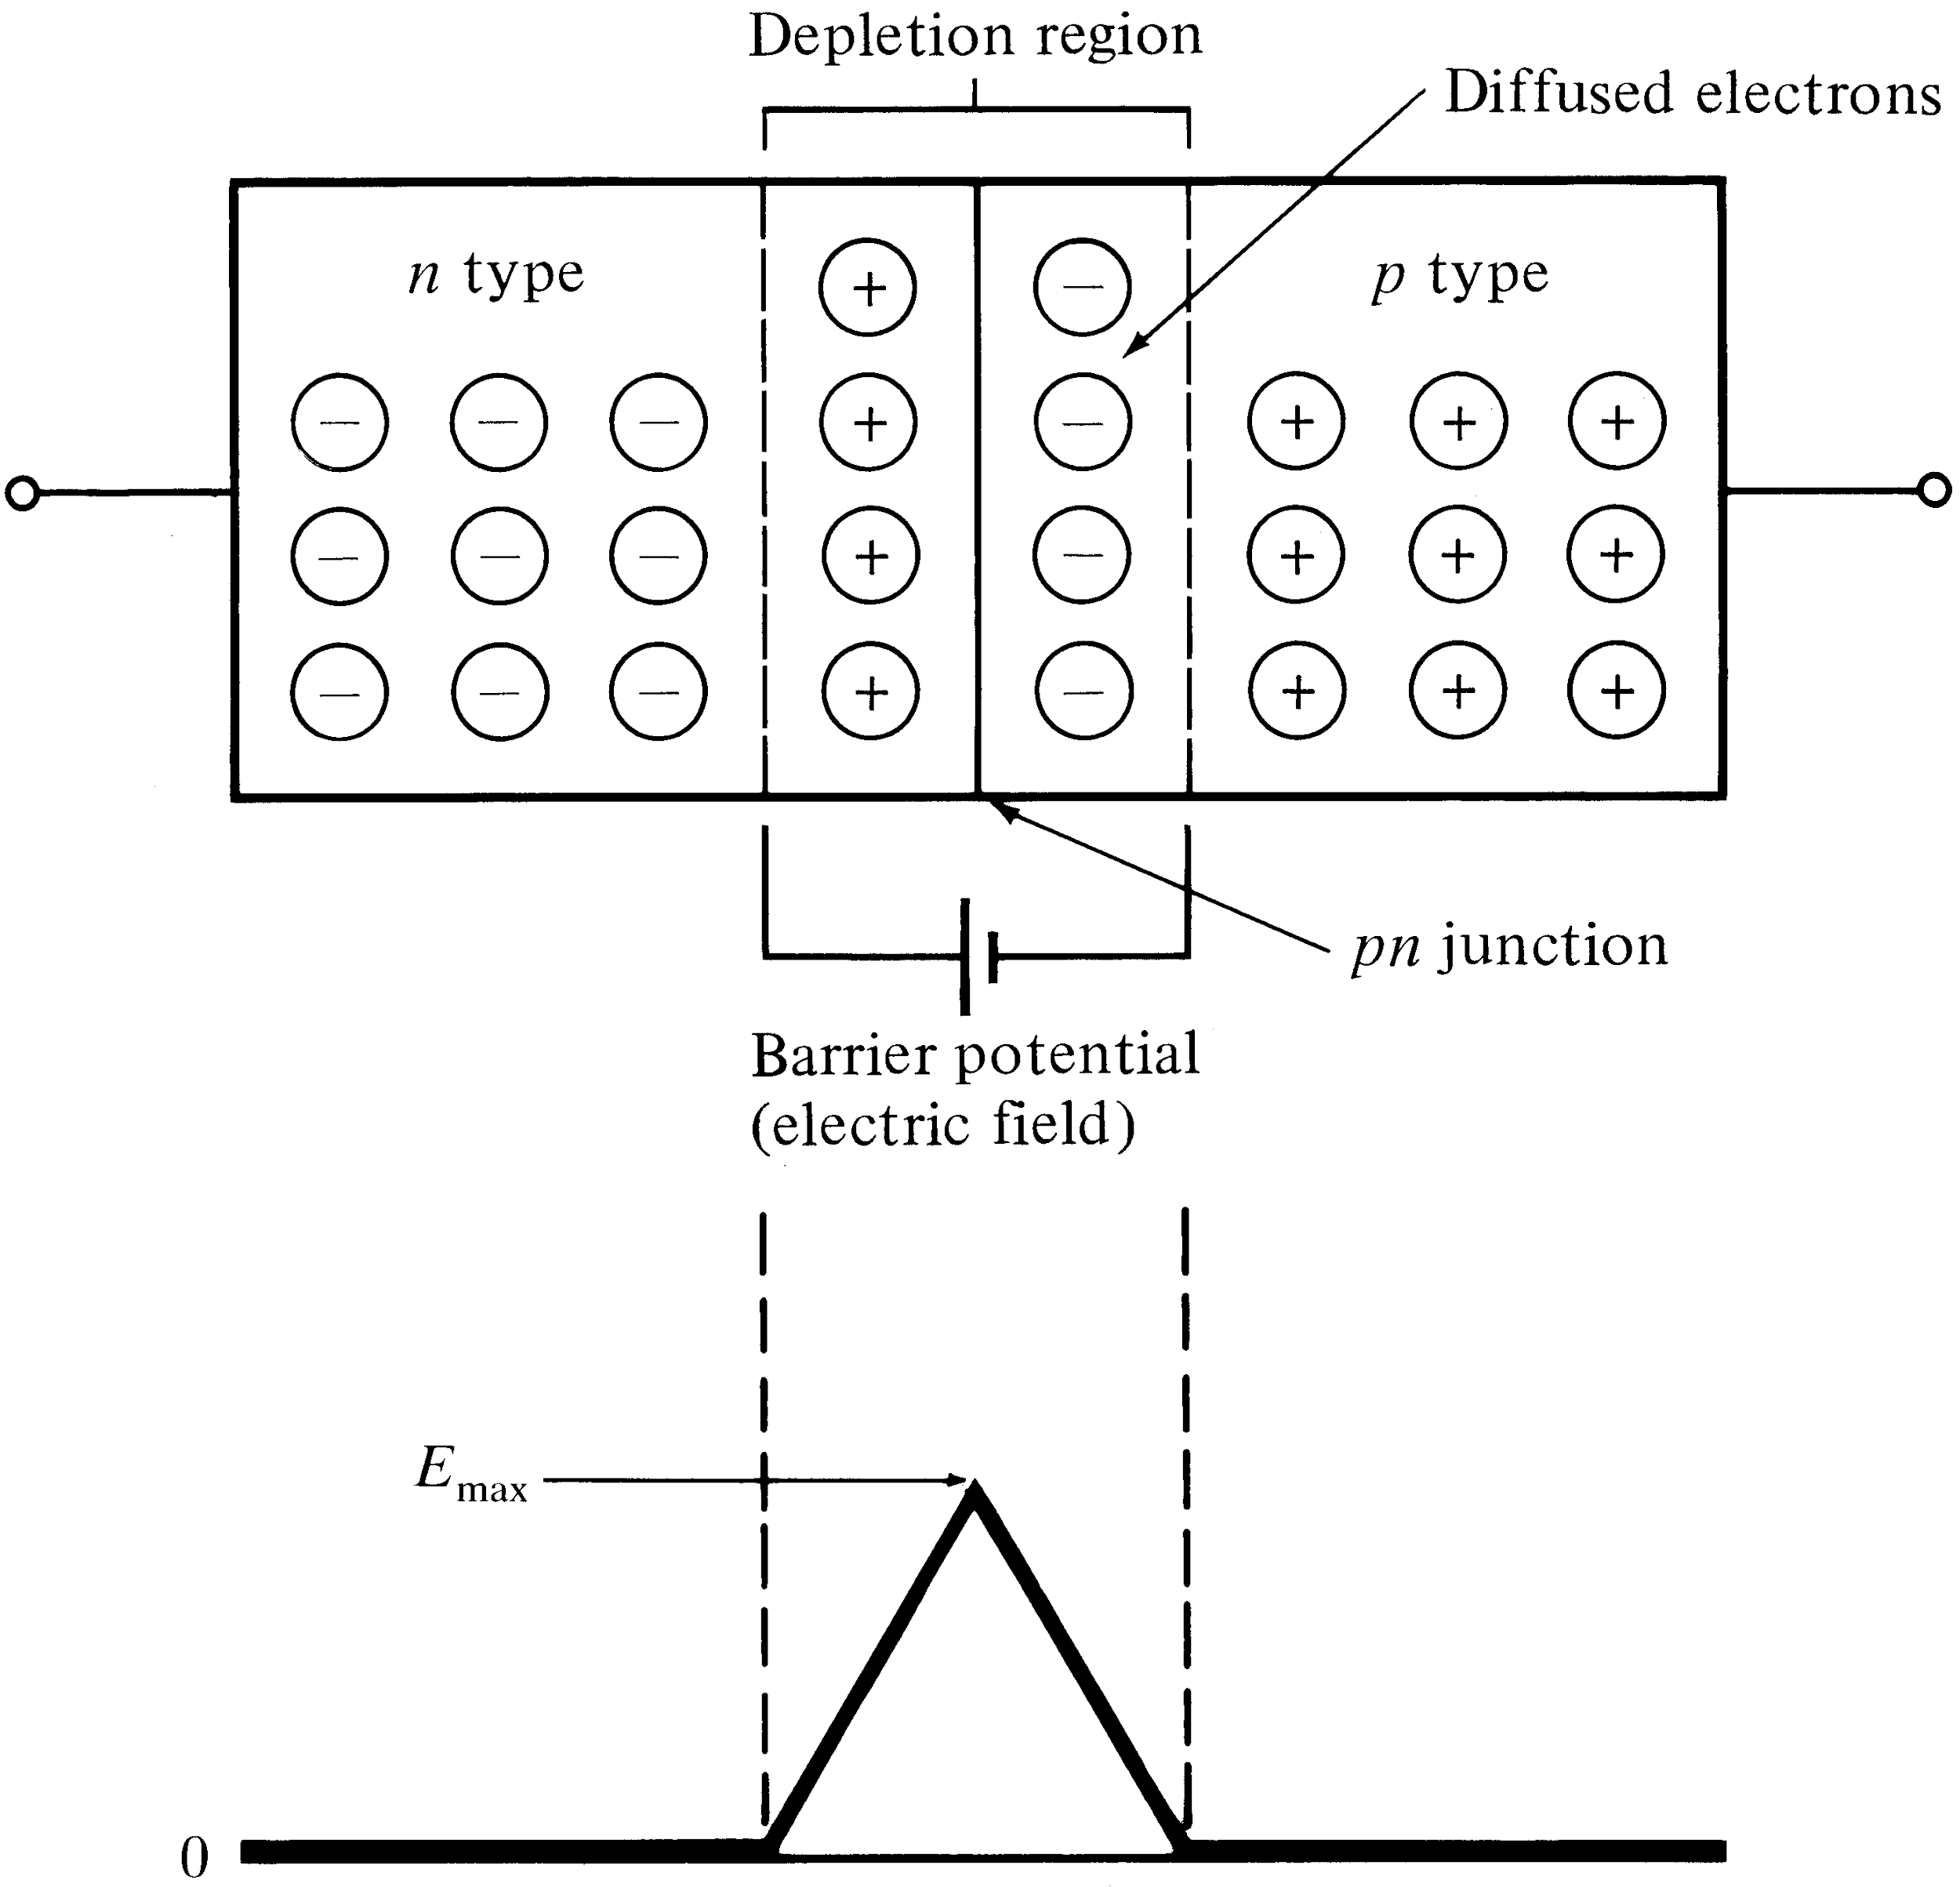
The pn Junction
Electron diffusion across a pn junction
creates a barrier potential (electric field)
in the depletion region.
Optical Fiber communications, 3rd ed.,G.Keiser,McGrawHill, 2000

Slide 23
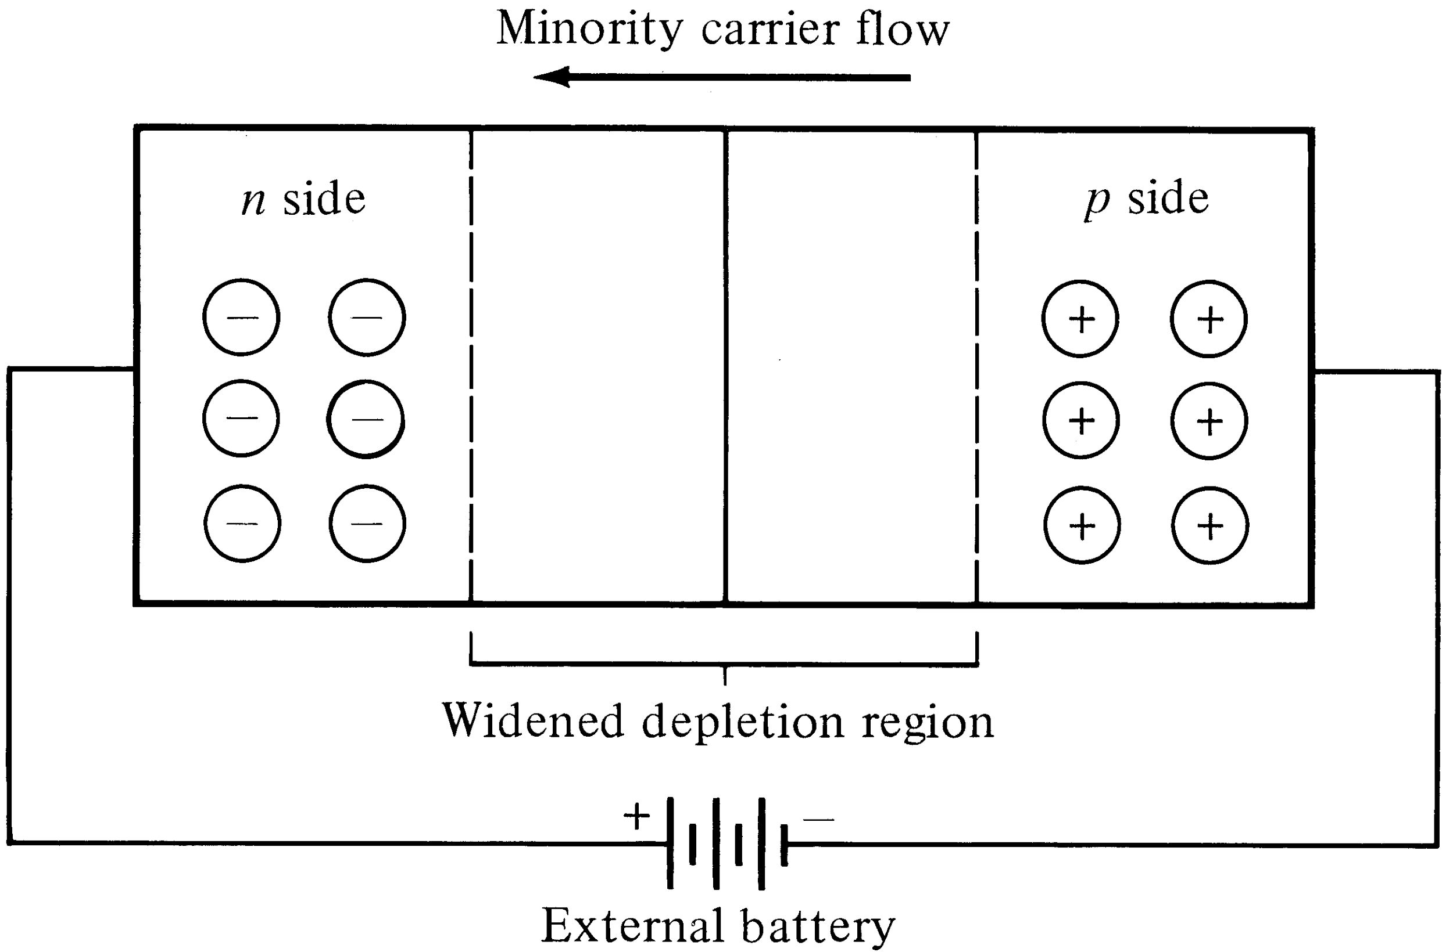
Reverse-biased pn Junction
A reverse bias widens the depletion region, but allows minority carriers to move freely with the applied field.
Optical Fiber communications, 3rd ed.,G.Keiser,McGrawHill, 2000

Slide 24
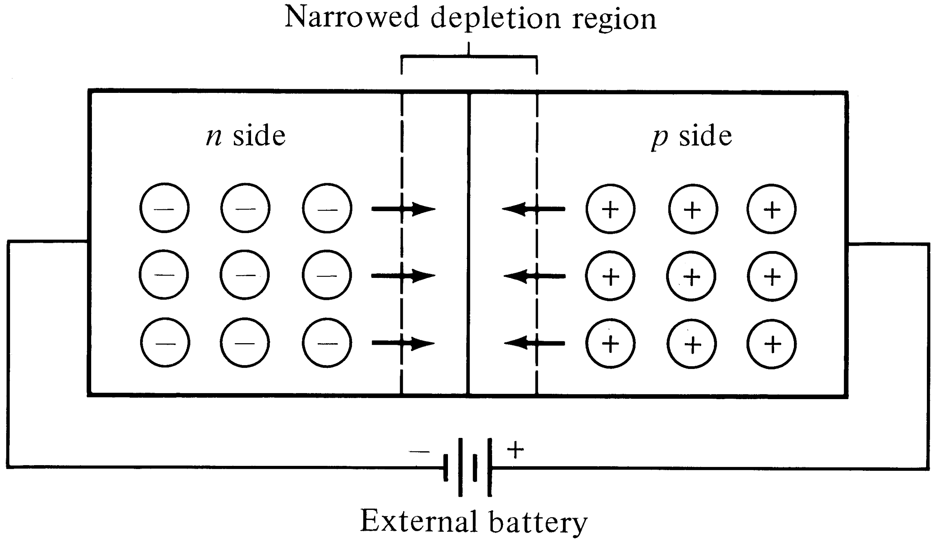
Forward-biased pn Junction
Lowering the barrier potential with a forward bias allows majority carriers to diffuse across the junction.
Optical Fiber communications, 3rd ed.,G.Keiser,McGrawHill, 2000

Slide 25
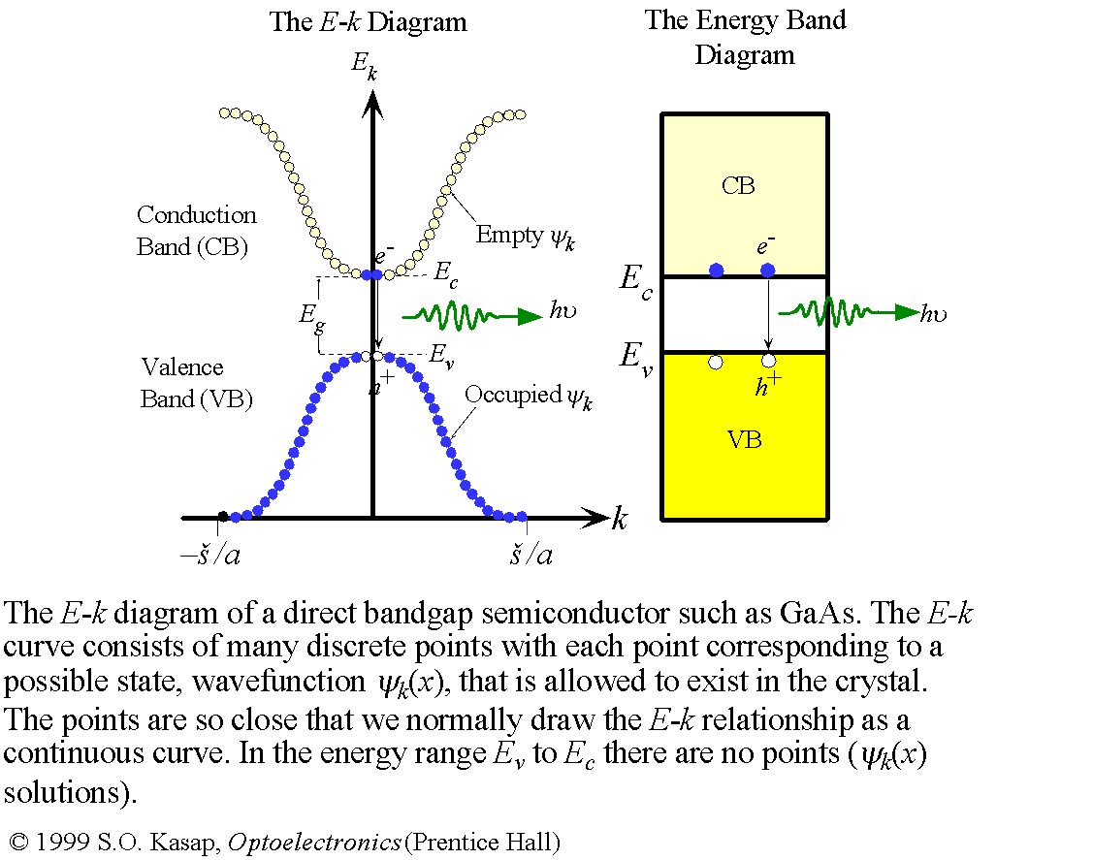
Direct Band Gap Semiconductors

Slide 26
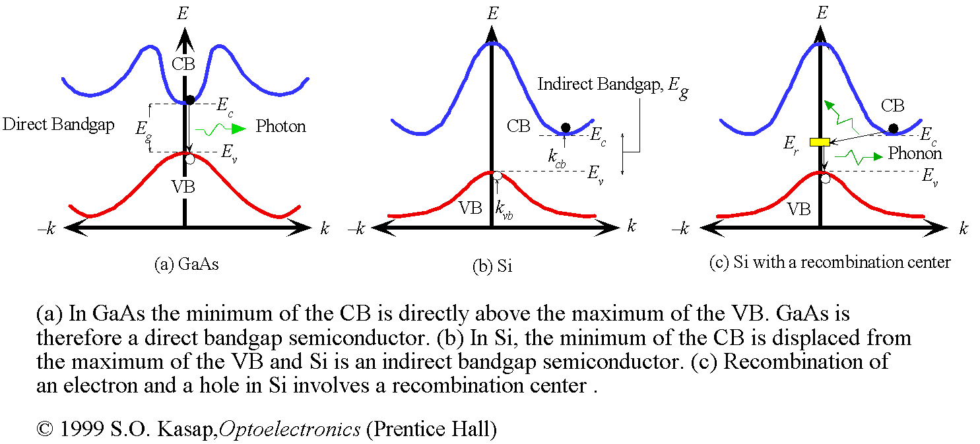
Indirect Band Gap Semiconductors

Slide 27
Light-Emitting Diodes (LEDs)
For photonic communications requiring data rate 100-200 Mb/s with multimode fiber with tens of microwatts, LEDs are usually the best choice.
LED configurations being used in photonic communications:
1- Surface Emitters (Front Emitters)
2- Edge Emitters

Slide 28
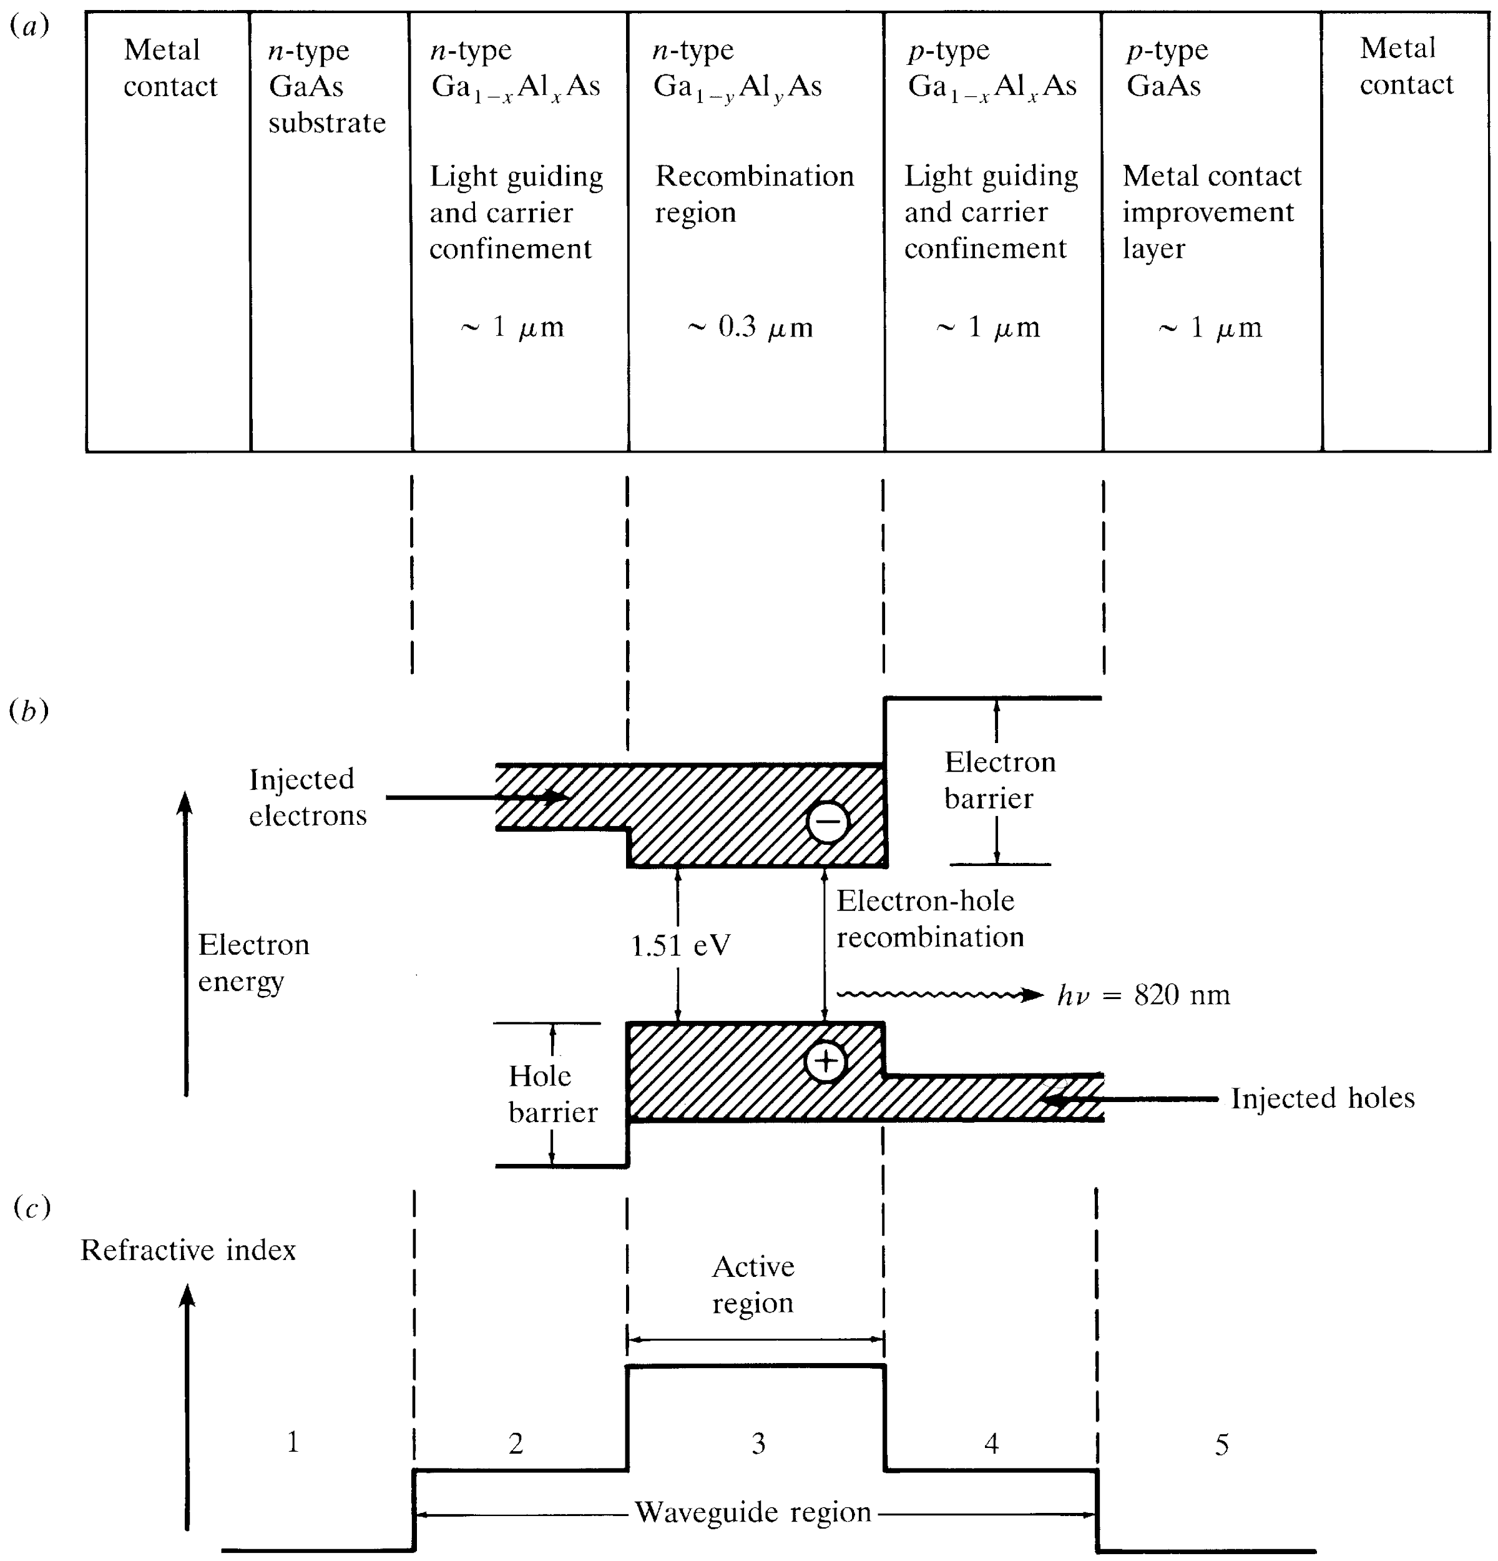
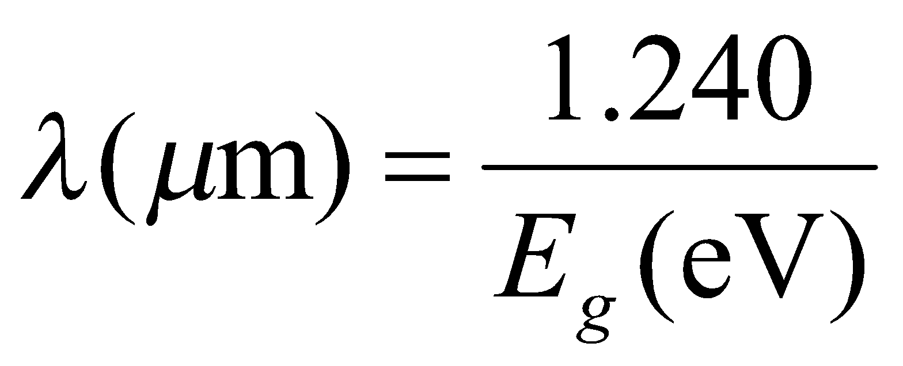
Cross-section drawing of a typical
GaAlAs double heterostructure light
emitter. In this structure, x>y to provide
for both carrier confinement and optical
guiding.
b) Energy-band diagram showing the
active region, the electron & hole
barriers which confine the charge carriers
to the active layer.
c) Variations in the refractive index; the
lower refractive index of the material in
regions 1 and 5 creates an optical barrier
around the waveguide because of the higher
band-gap energy of this material.
[4-3]
Optical Fiber communications, 3rd ed.,G.Keiser,McGrawHill, 2000

